Slide 1
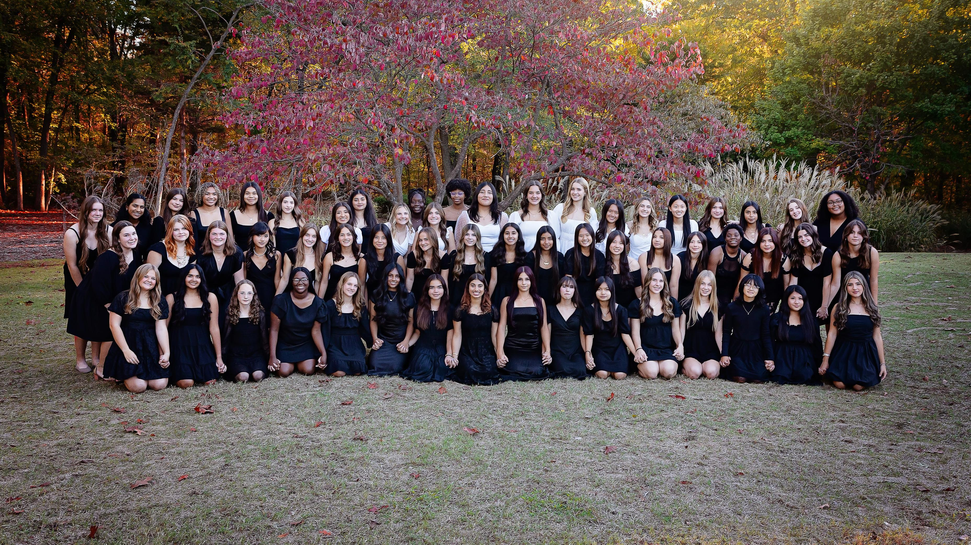
2025 Union Redhawk Invitational

Slide 2
 | Union Tourn | DATE: 3-2-22 |  |  |  | #1 Singles | LAFORTUNE
 | Sand Springs |  |  | Jasmine Crain |  |  | Union
Edmond North |  |  | Metro Christian | Heritage Hall | Heritage Hall |  |  | Bishop Kelley
15th Place |  |  |  |  | 0,0 |  |  | 7th Place
3,4 | Edmond North |  |  | Allie Brown |  |  | Bishop Kelley | 1,1
 |  | Booker T. Washington | E | Metro Christian | A | Heritage Hall
 |  | 1,0 |  |  |  | 0,0
 |  |  |  | Brianna Hernandez
 |  |  | Booker T. Washington | Union | Union
 |  |  |  |  | 4,5
 | Booker T. Washington |  |  | Penelope Shears |  |  | Heritage Hall
 | 1,1 |  |  | Booker T. Washington |  |  | 0,1
 |  |  |  | Aspen Irwin
 |  |  | Sand Springs | Cascia Hall | Cascia Hall
 |  |  |  |  | 0,0
 |  | McAlester | F | Daffney Snyder | B | Cascia Hall
 |  | 2,5 |  | Sand Springs |  | 4,2
 |  |  |  | Erica Galvez
 |  |  | McAlester | McAlester | Bixby
NOAH |  | McAlester |  |  | 0,1 | Cascia Hall |  | Riverfield
Consolation Champ | Stillwater |  |  | Caelie Cox |  |  | Cascia Hall | Champion
3, 4, (7) | 11th Place |  |  | Bixby |  |  | 3rd Place | 2, 5,(8)
 | 0,0 | Stillwater |  |  |  | Edmond Memorial | 5,4
 |  |  |  | Lauren Krise
 |  |  | Owasso | Edmond Memorial | Edmond Memorial
 |  |  |  |  | 2.0
 |  | NOAH | G | Abby Coleman | C | Edmond Memorial
 |  | 0,3 |  | Owasso |  | 2,1
 |  |  |  | Victoria Seach
 |  |  | NOAH | NOAH | Broken Arrow
 |  |  |  |  | 2,5
 | NOAH |  |  | London Walker |  |  | Riverfield
 | 4,2 |  |  | Broken Arrow |  |  | 1,2
 |  |  |  | Laila Wong
 |  |  | Stillwater | Bishop Kelley | Bishop Kelley
 |  |  |  |  | 3,2
 |  | Stillwater | H | Kori Gallegos | D | Riverfield
 |  | 4,1 |  | Stillwater |  | 3,3
 |  |  |  | Claire Reed
 |  |  | Edmond North | Edmond North | Riverfield
 |  |  |  |  | 0,0
 |  |  |  | Lily Clark
 |  | Metro Christian |  | Riverfield |  | Union
 | Metro Christian | Loser E |  |  |  | Loser A | Bixby
 | 3,2,(5) |  |  |  |  |  | 0,0
 |  | Sand Springs |  |  |  | Bixby
Owasso |  | Loser F |  |  |  | Loser B |  | Broken Arrow
13th Place |  | Owasso |  |  |  | Broken Arrow |  | 5th Place
0,2 | Owasso | Loser G |  |  |  | Loser C | Broken Arrow | 5,3
 | 5,4 |  |  |  |  |  | 5,1,(10)
 |  | Edmond North |  |  |  | Bishop Kelley
 |  | Loser H |  |  |  | Loser D
#1 Singles

Slide 3
 | Union Tourn | DATE: 3-2-22 |  |  |  | #2 Singles | LAFORTUNE
 | Owasso |  |  | Hattie Bradford |  |  | Bye
Owasso |  |  | Owasso | Heritage Hall | Heritage Hall |  |  | Stillwater
15th Place |  |  |  |  | 0,0 |  |  | 7th Place
0,0 | Sand Springs |  |  | Jocelyn Huggins |  |  | Stillwater
 |  | Union | E | Owasso | A | Heritage Hall
 |  | 4,5 |  |  |  | 0,0
 |  |  |  | Nicole Mendoza
 |  |  | Union | Union | Broken Arrow
 |  |  |  |  | 3,5
 | Union |  |  | Caterina Ongari |  |  | Heritage Hall
 | 4,1 |  |  | Broken Arrow |  |  | 2,0
 |  |  |  | Callie Hillock
 |  |  | McAlester | NOAH | NOAH
 |  |  |  |  | 2,0
 |  | McAlester | F | Addison Pennington | B | NOAH
 |  | 1,4,(6) |  | McAlester |  | 6,3
 |  |  |  | Elizabeth Wing
 |  |  | Metro Christian | Metro Christian | Bishop Kelley
Edmond North |  | McAlester |  |  | 4,2 | NOAH |  | Heritage Hall
Consolation Champ | Bixby |  |  | Taylor Neal |  |  | Riverfield | Champion
5,1 | 11th Place |  |  | Bishop Kelley |  |  | 3rd Place | 1,2
 | 3,1 | Bixby |  |  |  | Riverfield | 6, 3, (5)
 |  |  |  | Allie Dolezal
 |  |  | Bixby | Edmond Memorial | Edmond Memorial
 |  |  |  |  | 1,4
 |  | Bixby | G | Ava Hawkins | C | Riverfield
 |  | 2,0 |  | Bixby |  | 1,2
 |  |  |  | Anika Platvoet
 |  |  | Booker T. Washington | Booker T. Washington | Riverfield
 |  |  |  |  | 5,1
 | Edmond North |  |  | Zoe Jackson |  |  | Cascia Hall
 | 0,2 |  |  | Riverfield |  |  | 1,1
 |  |  |  | Kennedy Orr
 |  |  | Edmond North | Edmond North | Stillwater
 |  |  |  |  | 3,3
 |  | Edmond North | H | Stella Dzialowski | D | Cascia Hall
 |  | 1,0 |  | Stillwater |  | 1,1
 |  |  |  | Jessie Desaire
 |  |  | Sand Springs | Sand Springs | Cascia Hall
 |  |  |  |  | 0,0
 |  |  |  | Sophie Lauinger
 |  | Owasso |  | Cascia Hall |  | Broken Arrow
 | Metro Christian | Loser E |  |  |  | Loser A | Broken Arrow
 | 1,3 |  |  |  |  |  | 3,2-0 Inj. Def.
 |  | Metro Christian |  |  |  | Bishop Kelley
Booker T. Washington |  | Loser F |  |  |  | Loser B |  | Edmond Memorial
13th Place |  | Booker T. Washington |  |  |  | Edmond Memorial |  | 5th Place
2, 3, (12) | Booker T. Washington | Loser G |  |  |  | Loser C | Edmond Memorial | 3,4
 | 0,0 |  |  |  |  |  | 3, 4, (5)
 |  | Sand Springs |  |  |  | Stillwater
 |  | Loser H |  |  |  | Loser D
#2 Singles

Slide 4
 | Union Tourn | DATE: 3-2-22 |  |  |  | #1 Doubles | UTC
 | Sand Springs |  |  | Henderson/Nasr |  |  | Owasso
Sand Springs |  |  | NOAH | Heritage Hall | Heritage Hall |  |  | Owasso
15th Place |  |  |  |  | 1,0 |  |  | 7th Place
3,2 | McAlester |  |  | Cassidy/Nunley |  |  | Union | 4,1,(8)
 |  | Edmond North | E | NOAH | A | Heritage Hall
 |  | 3,2,(6) |  |  |  | 1,1
 |  |  |  | Hall/Vaughan
 |  |  | Edmond North | Stillwater | Stillwater
 |  |  |  |  | 1,2
 | Bishop Kelley |  |  | Fox/Knox |  |  | Bixby
 | 5,6,(5) |  |  | Edmond North |  |  | 3,3,(4)
 |  |  |  | Cooper/Gerkin
 |  |  | Bishop Kelley | Bishop Kelley | Owasso
 |  |  |  |  | 2,2
 |  | Bishop Kelley | F | Russell/Stuart | B | Bixby
 |  | 1,0 |  | Owasso |  | 2,0
 |  |  |  | Alvarez/Horton
 |  |  | Sand Springs | Sand Springs | Bixby
Bishop Kelley |  | Edmond North |  |  | 0, | Heritage Hall |  | Bixby
Consolation Champ | Edmond North |  |  | Gilliland/Quick |  |  | Heritage Hall | Champion
0,2 | 11th Place |  |  | Bixby |  |  | 3rd Place | 5,2
 | 2,0 | Riverfield |  |  |  | Edmond Memorial | 2,3
 |  |  |  | Beacham/Ruff
 |  |  | Metro Christian | Edmond Memorial | Edmond Memorial
 |  |  |  |  | 1,0
 |  | Metro Christian | G | Cunningham/Stratton | C | Edmond Memorial
 |  | 2,1 |  | Metro Christian |  | 1,4
 |  |  |  | Kelley/Melton
 |  |  | McAlester | McAlester | Union
 |  |  |  |  | 0,0
 | Metro Christian |  |  | Dehya/Tempest |  |  | Cascia Hall
 | 1,6,(6) |  |  | Union |  |  | 2,1,(7)
 |  |  |  | Cravotto/Harnish
 |  |  | Booker T. Washington | Broken Arrow | Broken Arrow
 |  |  |  |  | 2,0
 |  | Riverfield | H | Canada/Yar | D | Cascia Hall
 |  | 2,2 |  | Booker T. Washington |  | 2,1
 |  |  |  | Moore/Walker
 |  |  | Riverfield | Riverfield | Cascia Hall
 |  |  |  |  | 1,3
 |  |  |  | Liles/Siegfried
 |  | NOAH |  | Cascia Hall |  | Stillwater
 | NOAH | Loser E |  |  |  | Loser A | Stillwater
 | 2,0 |  |  |  |  |  | 3,2
 |  | Sand Springs |  |  |  | Owasso
Did Not Report |  | Loser F |  |  |  | Loser B |  | Stillwater
13th Place |  | McAlester |  |  |  | Union |  | 5th Place
 | Booker T. Washington | Loser G |  |  |  | Loser C | Broken Arrow | 1,4
 | 3,2 |  |  |  |  |  | 4,4,(1)
 |  | Booker T. Washington |  |  |  | Broken Arrow
 |  | Loser H |  |  |  | Loser D
#1 Doubles

Slide 5
 | Union Tourn | DATE: 3-2-22 |  |  |  | #2 Doubles | UTC
 | McAlester |  |  | Norwood/Sutton |  |  | Broken Arrow
McAlester |  |  | McAlester | Stillwater | Stillwater |  |  | Broken Arrow
15th Place |  |  |  |  | 0,0 |  |  | 7th Place
5 ,2 (7) | Booker T. Washington |  |  | Ayers/Swing |  |  | Edmond North | 2, 2, (4)
 |  | Bishop Kelley | E | McAlester | A | Stillwater
 |  | 0,1 |  |  |  | 3,3
 |  |  |  | Birch/Hynes
 |  |  | Bishop Kelley | Broken Arrow | Broken Arrow
 |  |  |  |  | 4,1
 | Owasso |  |  | Gallop/Miller |  |  | Stillwater
 | 6,4,(11) |  |  | Bishop Kelley |  |  | 1,2
 |  |  |  | Munson/C.Trendle
 |  |  | Riverfield | Edmond Memorial | Edmond Memorial
 |  |  |  |  | 2,1
 |  | Owasso | F | Diaz/Kiker | B | Bixby
 |  | 2,4 |  | Riverfield |  | 4,3
 |  |  |  | Bahruth/Dunaway
 |  |  | Owasso | Owasso | Bixby
Owasso |  | Bishop Kelley |  |  | 0,2 | Bixby |  | Cascia Hall
Consolation Champ | Bishop Kelley |  |  | Hay/Yoas |  |  | Union | Champion
3,0 | 11th Place |  |  | Bixby |  |  | 3rd Place | 6, 0, (7)
 | 2,2 | Metro Christian |  |  |  | Union | 1,3
 |  |  |  | Alexander/Ramasamy
 |  |  | Sand Springs | Union | Union
 |  |  |  |  | 0,0
 |  | Metro Chrsitian | G | Boyles/Fitz | C | Union
 |  | 1,1 |  | Sand Springs |  | 2,2
 |  |  |  | Fillmore/Riley
 |  |  | Metro Christian | Metro Christian | Edmond North
 |  |  |  |  | 3,0
 | NOAH |  |  | Shoemake/Wang |  |  | Cascia Hall
 | 3,5 |  |  | Edmond North |  |  | 5,6,(6)
 |  |  |  | Butler/Griffin
 |  |  | NOAH | Cascia Hall | Cascia Hall
 |  |  |  |  | 0,1
 |  | NOAH | H | Anton/Barnes | D | Cascia Hall
 |  | 4,1 |  | NOAH |  | 4,3
 |  |  |  | Gonzalez/Gruntkowski
 |  |  | Booker T. Washington | Booker T. Washington | Heritage Hall
 |  |  |  |  | 1,0
 |  |  |  | Shouse/Trice
 |  | McAlester |  | Heritage Hall |  | Broken Arrow
 | Riverfield | Loser E |  |  |  | Loser A | Edmond Memorial
 | 0,2 |  |  |  |  |  | 3,4,(8)
 |  | Riverfield |  |  |  | Edmond Memorial
Riverfield |  | Loser F |  |  |  | Loser B |  | Heritage Hall
13th Place |  | Sand Springs |  |  |  | Edmond North |  | 5th Place
0,2 | Sand Springs | Loser G |  |  |  | Loser C | Heritage Hall | 3,2
 | 1,4,(8) |  |  |  |  |  | 2,0
 |  | Booker T. Washington |  |  |  | Heritage Hall
 |  | Loser H |  |  |  | Loser D
#2 Doubles

